Slide 1

Business Intelligence
“Tasks and Analysis Formats”

Slide 2
Data Task
Structural properties of the enterprise and the registered customers, the transactional data from business process instances, the data describing production activities, or traces of activities in social networks.
Relies on data modeling techniques encompassing different data models like ER models, UML, or semistructured data models, including methods on how to apply the models, and an IT infrastructure for data provisioning

Slide 3
Business and Data Understanding Task
It is not reasonable to use all possible parameters informing about the health status of a patient for monitoring a specific treatment process. Instead, a number of potential influential factors are selected according to expert knowledge, belief, and interest. In other words, knowledge about the process is mapped to a number of variables also taking into account factors that are probably not part of the established knowledge.

Slide 4
Modeling Task
Example, the model formulation for analyzing a KPI in connection with customer acquisition:
One can start with a marketing-oriented approach, take the customer perspective, and identify factors that attract new customers. After the identification of these factors, one can think about the necessary internal processes meeting the customer requirements.

Slide 5
Modeling Task
Another approach is to start with the production perspective, scrutinize the production process, develop possible scenarios for changes of the production processes. Afterwards, the different scenarios are analyzed with respect to the attractiveness for customers.

Slide 6
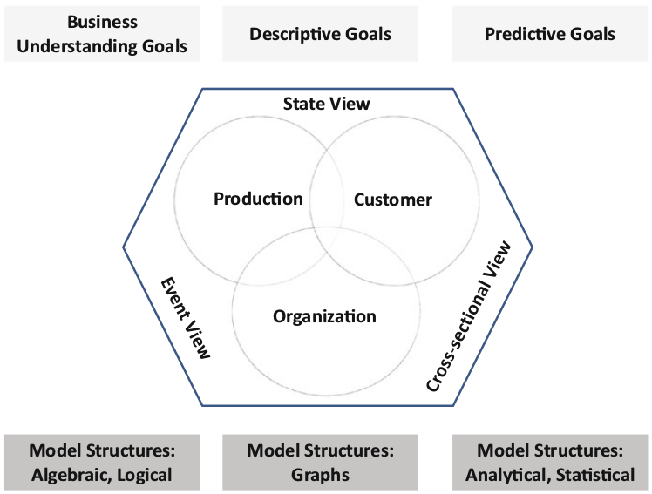
Modeling Task

Slide 7
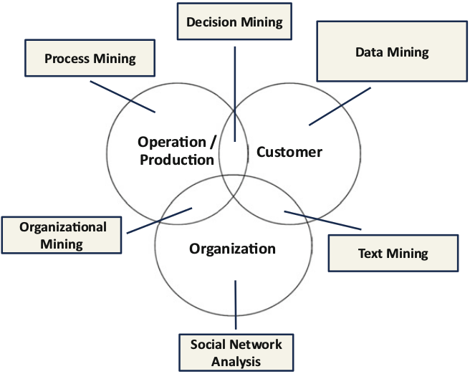
Analysis Task

Slide 8
Evaluation and Reporting Task
The first one is evaluation of the results in context of the analytical goal.
The second one is evaluation from a global business perspective, i.e., understanding the results of the analysis in the context of the business.

Slide 9
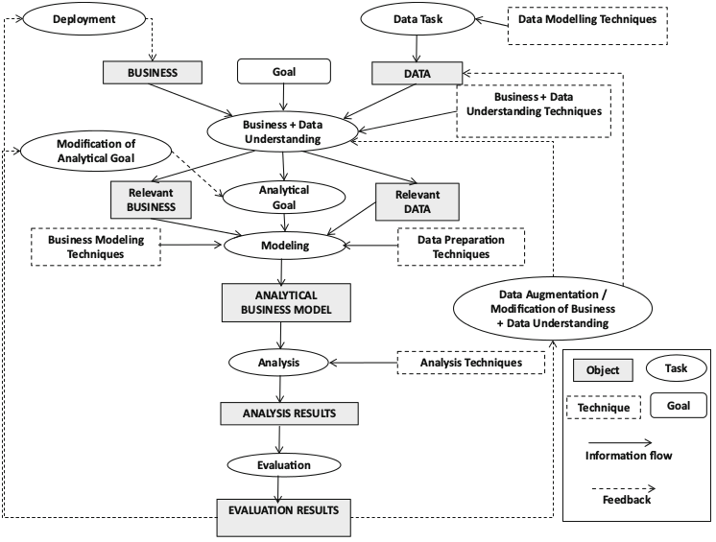
Analysis Formats (iMine)

Slide 10
The iMine Method: Basic Ingredients
Objects: Rectangles with full borders represent the objects that are analyzed or produced during the BI process along the three goal perspectives.
• Tasks: Ellipses represent the BI tasks that have to be conducted by the BI analyst.

Slide 11
The iMine Method: Basic Ingredients
Techniques: Rectangles with dashed border represent techniques for the different BI tasks. Techniques consist of repositories for procedures, methods for using the procedures, and tools for implementation.
• Information flow: Solid arrows represent the flow of information.

Slide 12
The iMine Method: Basic Ingredients
Feedback: Dashed arrows refer to possible feedback loops.
• Analysis goals: Analysis goals are depicted as rectangles with rounded corners.

Slide 13
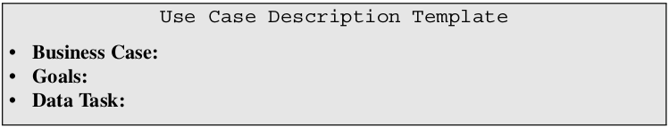
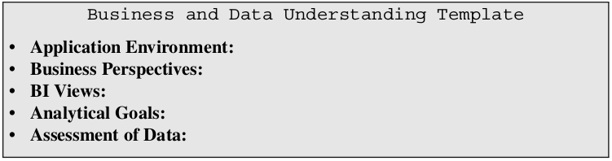
Use Cases

